Slide 1
Introduction to Multimodal Learning
Gwangwoo Kim
Apr. 21, 2023

Slide 2
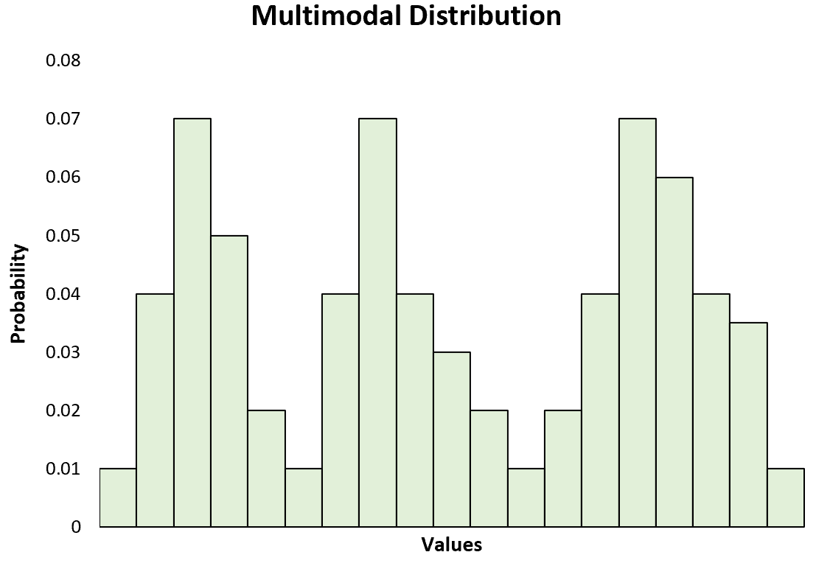
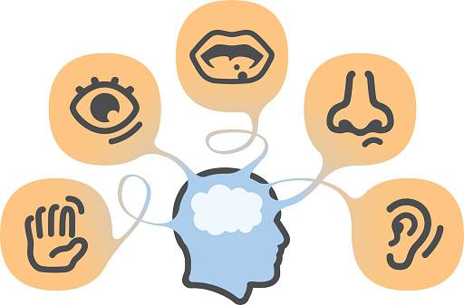
Introduction

Slide 3
History
The “behavioral” era (1970s until late 1980s)
The “computational” era (late 1980s until 2000)
The “interaction” era (2000 - 2010)
The “deep learning” era (2010s until …)

Slide 4
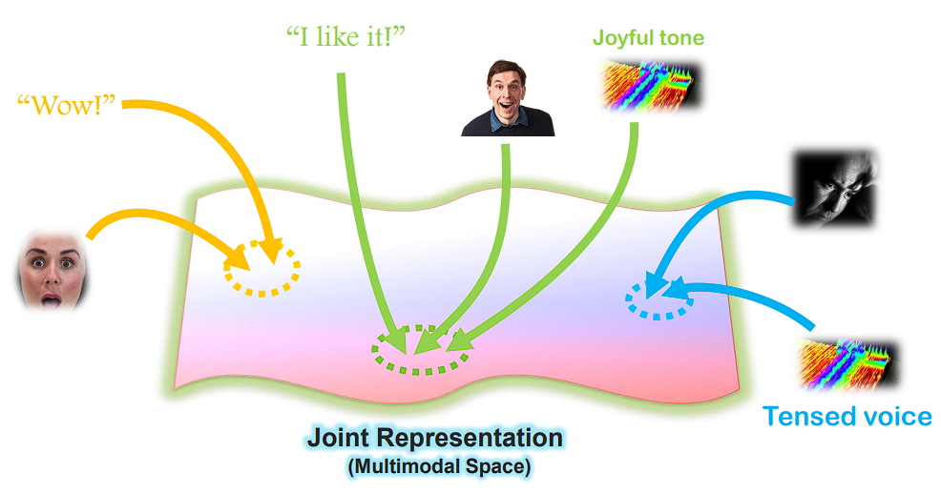
Core Challenge 1: Representation

Slide 5
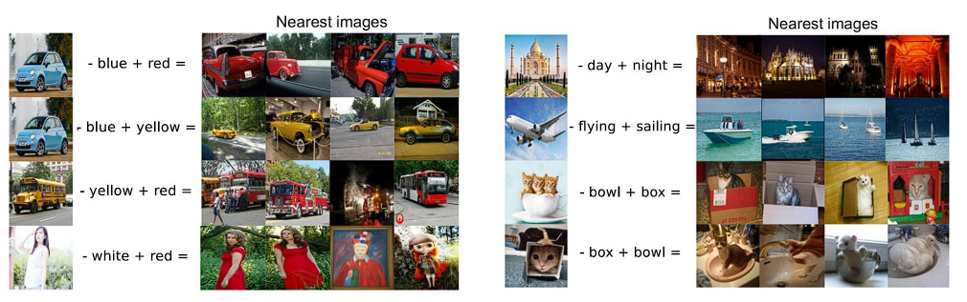
Core Challenge 1: Representation

Slide 6
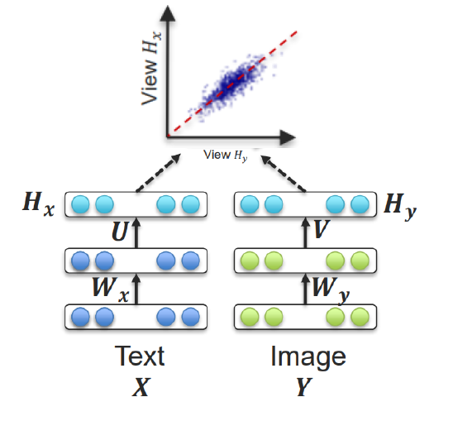
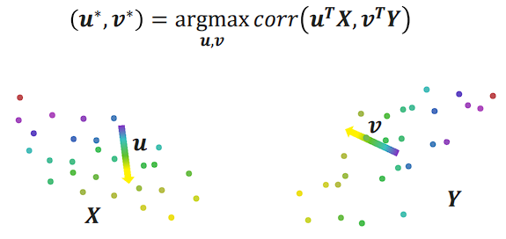
Core Challenge 1: Representation

Slide 7
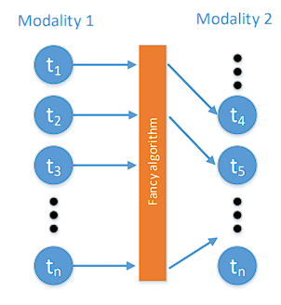
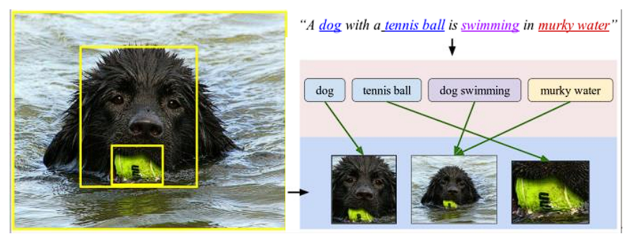
Core Challenge 2: Alignment

Slide 8
Multimodal Deep Learning
Gwangwoo Kim
Apr. 21, 2023

Slide 9
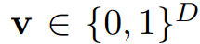
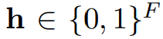
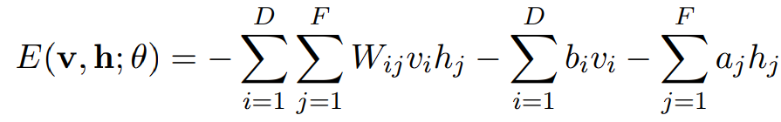
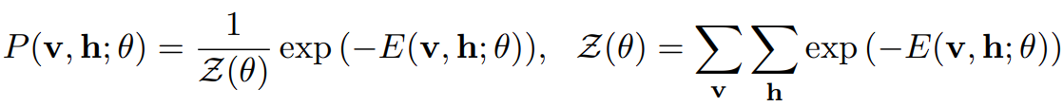
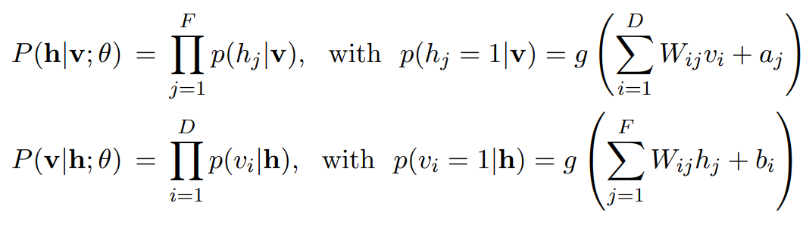
Restricted Boltzmann Machines
Let and
Define the energy function by
The generative model is

Slide 10
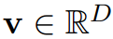
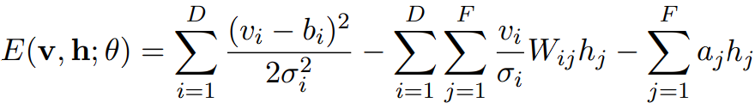
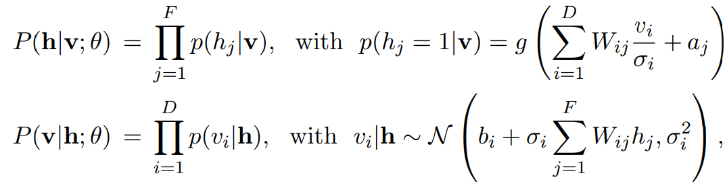
Gaussian-Bernoulli RBM
Let and
Define the energy function by
The generative model is

Slide 11
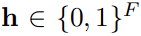
Replicated Softmax Model
The Replicated Softmax Model is useful for modeling sparse count data, such as word count vectors in a document.
Let K be the dictionary size, M be the number of words appearing in a document, and be binary stochastic hidden topic features
Let V be a M x K observed binary matrix v_ik = 1 iff the i th word in the document is the k th dictionary word.

Slide 12
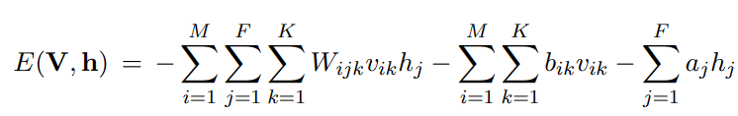
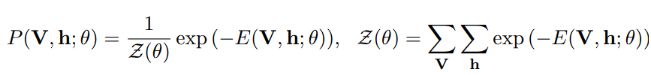
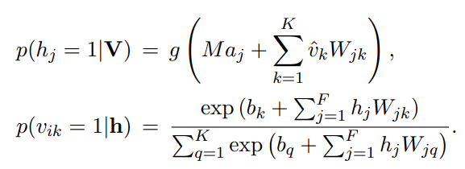
Replicated Softmax Model

Slide 13
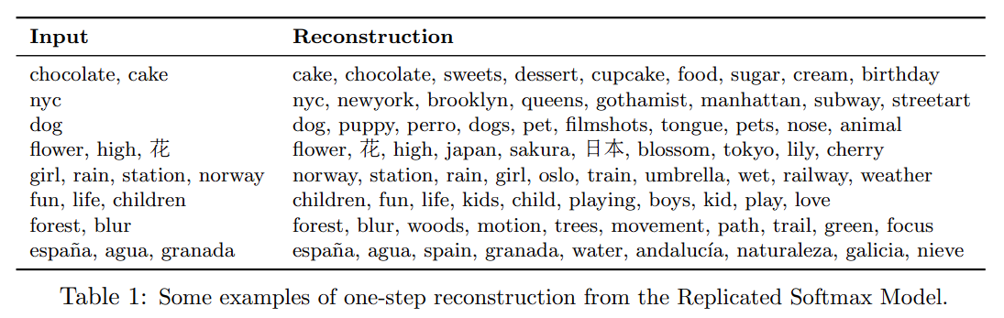
Replicated Softmax Model

Slide 14
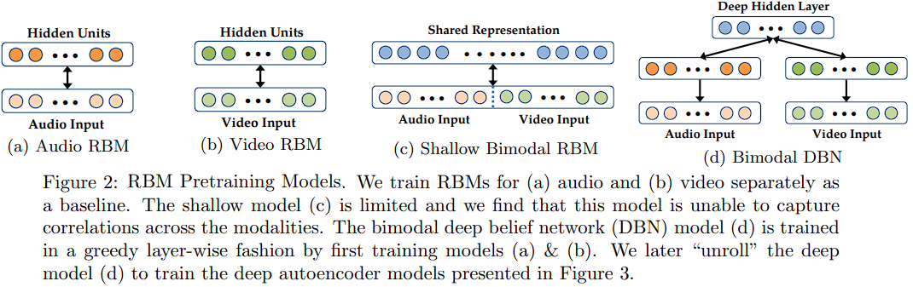
Multimodal Deep Learning

Slide 15
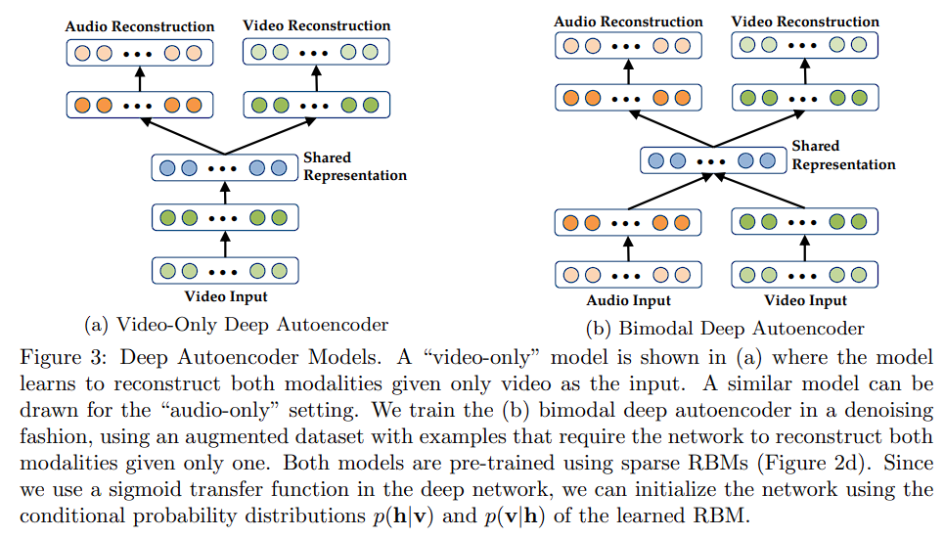
Multimodal Deep Learning

Slide 16
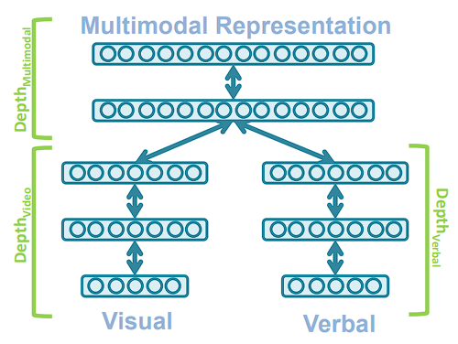
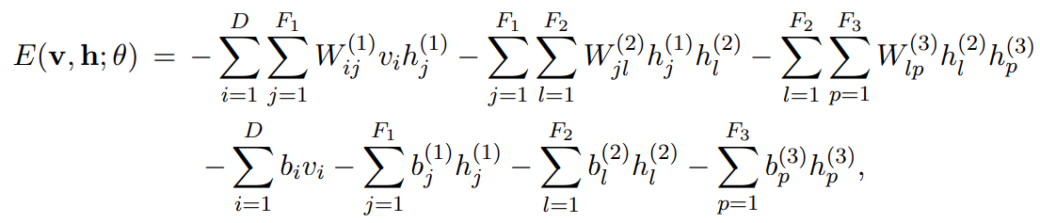
Deep Boltzmann Machines

Slide 17
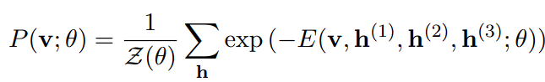
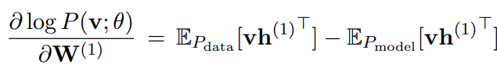
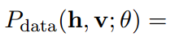
Deep Boltzmann Machines
where

Slide 18
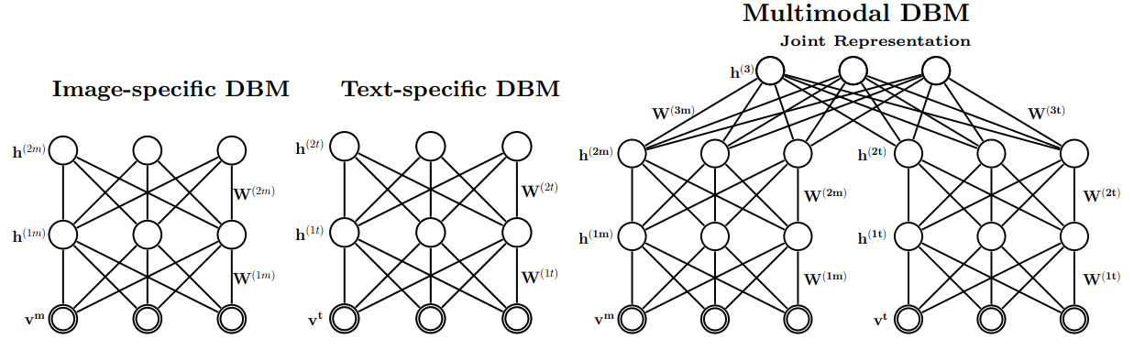
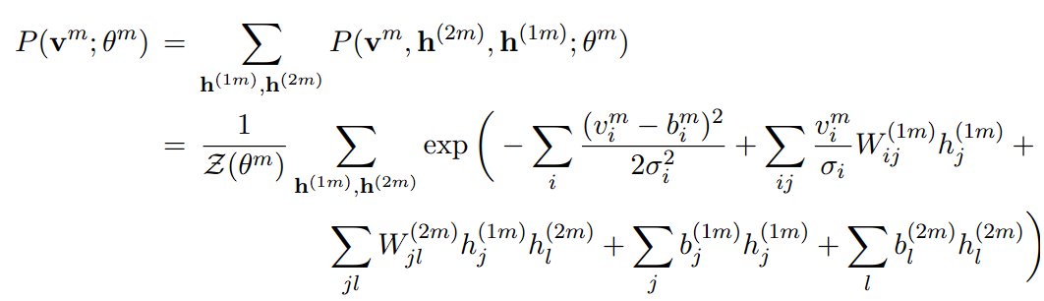
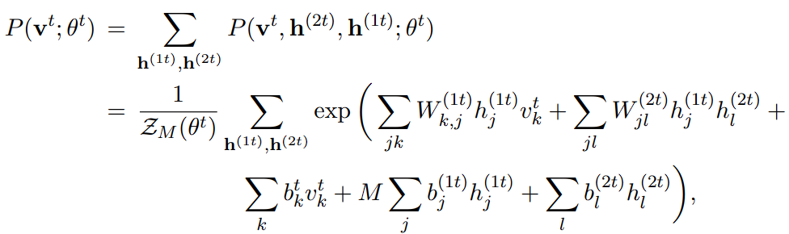
Multimodal Deep Boltzmann Machines

Slide 19
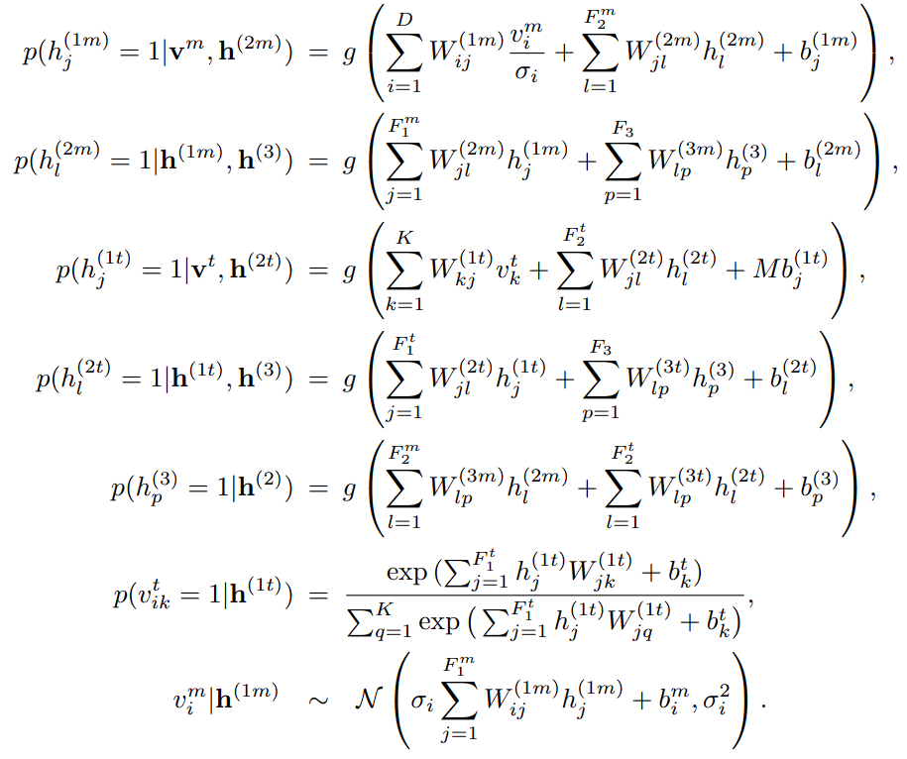
Multimodal Deep Boltzmann Machines

Slide 20
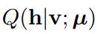
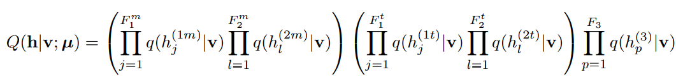
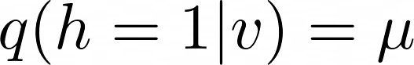
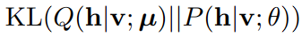
Approximate Inference and Learning
We introduce a variational distribution
where
Goal: optimize

Slide 21
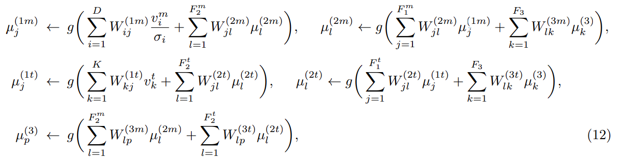
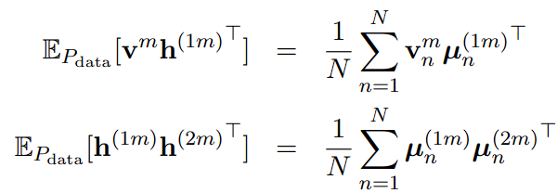
Approximate Inference and Learning

Slide 22
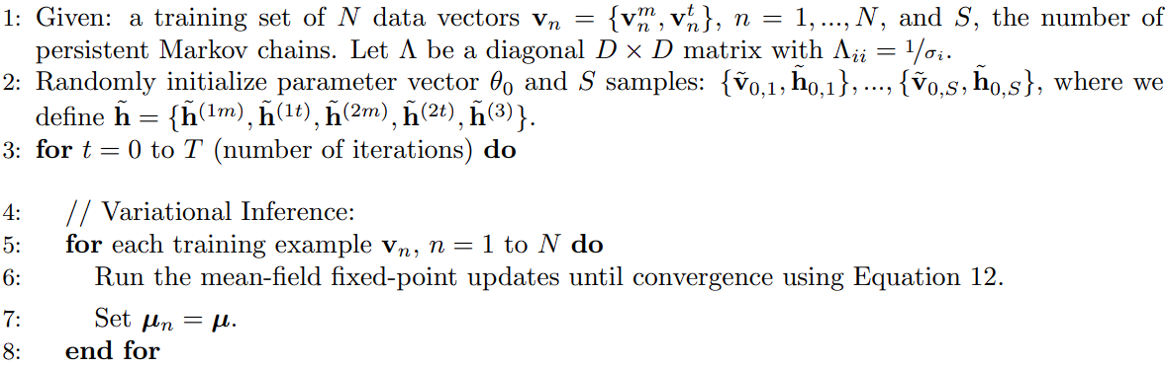
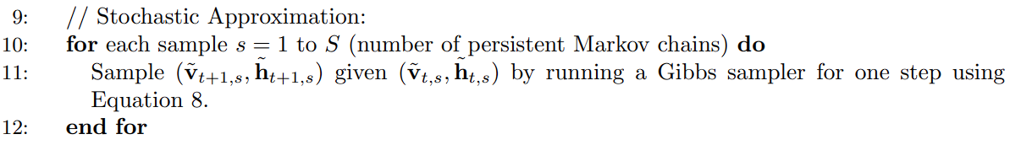
Learning Procedure for a Multimodal Deep Boltzmann Machine

Slide 23
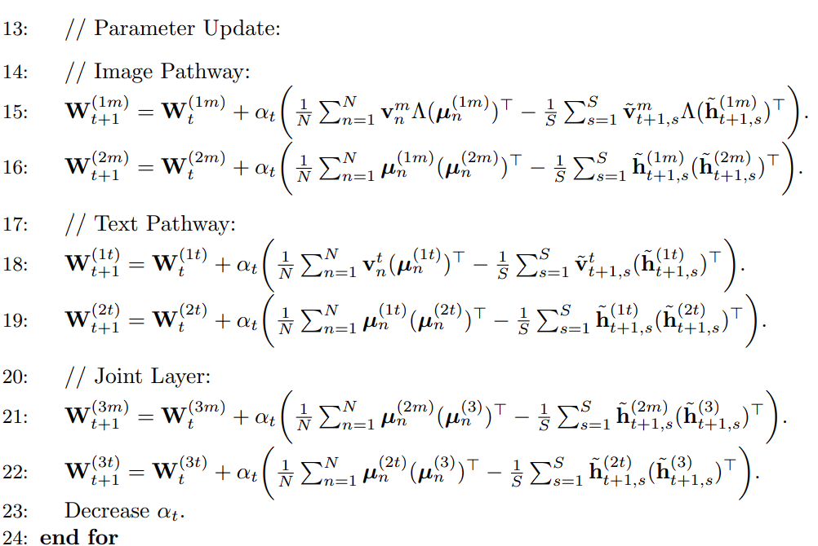
Learning Procedure for a Multimodal Deep Boltzmann Machine

Slide 24
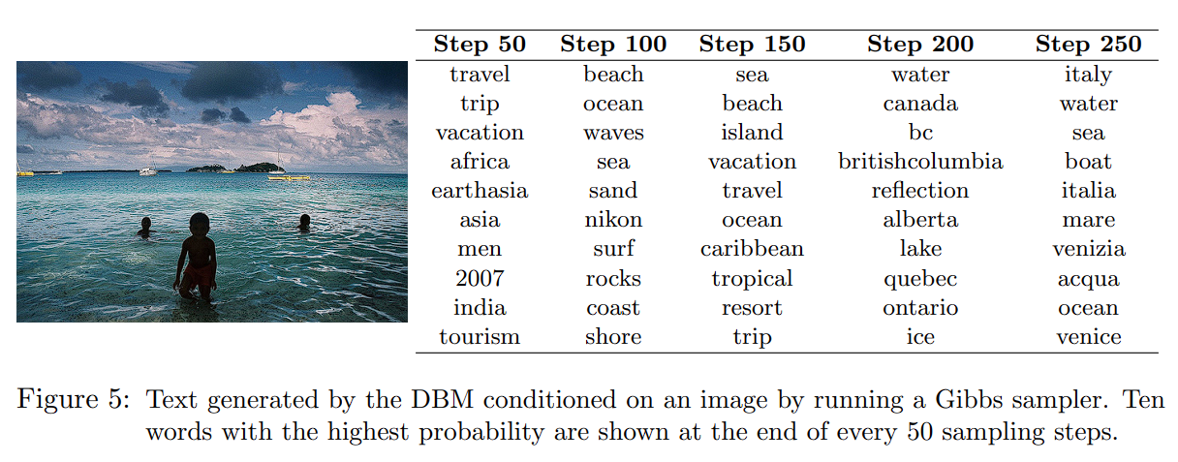
Generating Missing Modalities

Slide 25
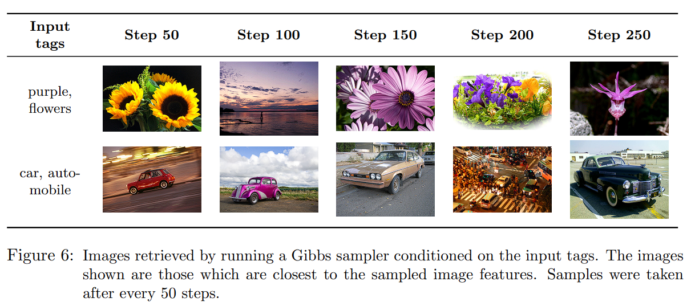
Generating Missing Modalities

Slide 26
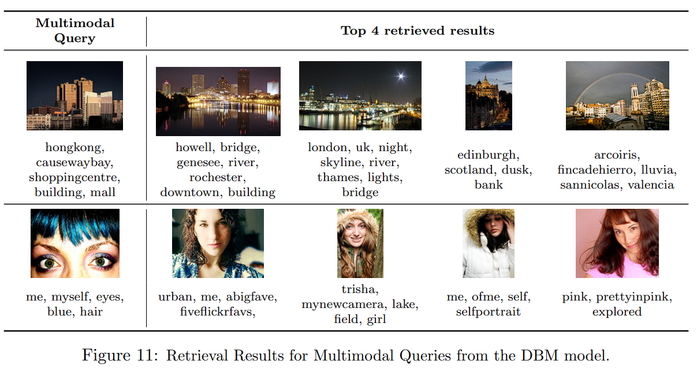
Inferring Joint Representations

Slide 27
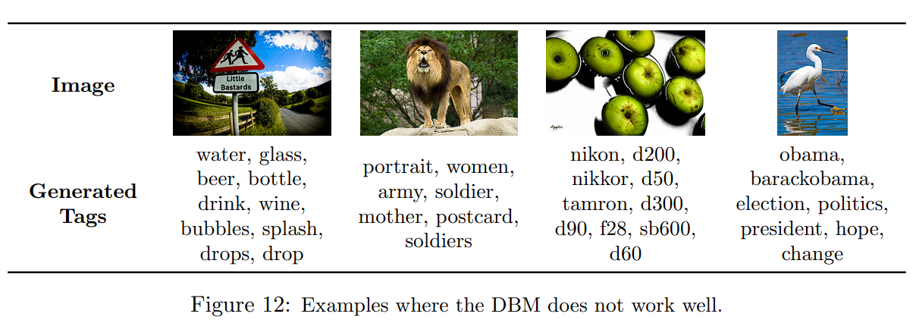
When Does the Model Not Work?

Slide 28
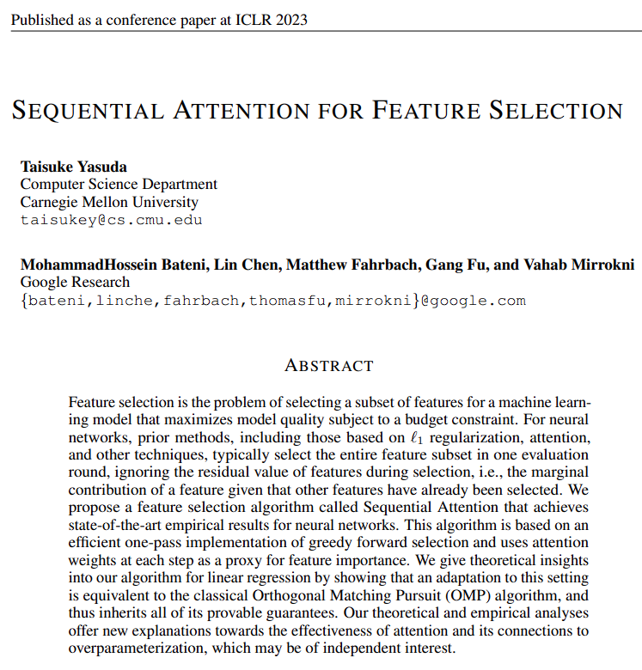
What’s next?

